Slide 1
Malawi Blood Giving Sets
Pothawira Surgical Center
Darcy Ayers, Micheala Harris,
Jason Hoffman, Hannah Kragt
Notes:
Hello my name is Hannah and my group members are Michaela, Darcy, and Jason. Today I am going to summarize the Create phase for our design project which encompasses creating blood giving sets in collaboration with Pothawira Surgical Center in Salima, Malawi.

Slide 2
Table of contents
Needs Statement
Existing Solutions
Brainstorming
Design Decisions
Gantt Chart
Design
Implementation
Notes:
During this presentation i will first discuss reiterate the needs statement for the project. Then I will highlight key findings from our Interview with our community partner. After I will outline our needs statement. Following I will address the design criteria for our solution. Finally I will

Slide 3
Needs Statement
∈ R^ρ
Notes:
Hannah
Does this need to be sentence too??

Slide 4
Problem Needs Statement Identifies Core Problem and Requirements
The Pothawira Surgical Center in Salima, Malawi requires an affordable, reusable, and sterilizable method for blood-giving sets to address the limited availability of single-use sets

Slide 5
Existing Solutions
Notes:
Michaela

Slide 6
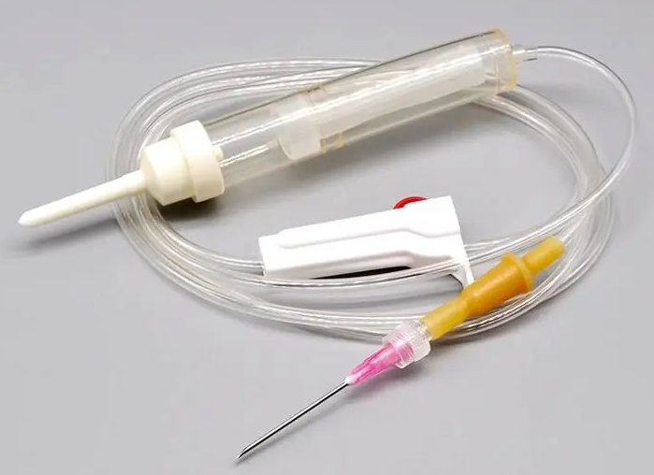
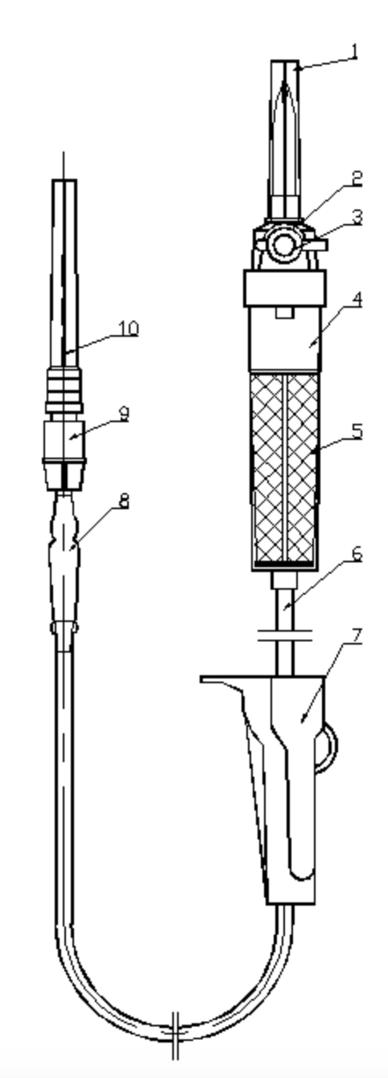
Disposable Sets are the Current Standard for Blood Transfusion
Pros
Cons
Sterile
No risk of cross-contamination
Comply with international standards ^{1,2}
To blood bag
Not reusable
Not easily sourced in Malawi ³
To patient
Standard Blood Transfusion Set ¹⁰
Sketch of Standard Set ¹²
1. "ISO 8536-4:2019 Transfusion Equipment for Medical Use - Part 4: Transfusion Sets for Single Use, Gravity Feed," International Organization for Standardization, 2019.
2. “ISO 10993-1:2018 Biological evaluation of medical devices - Part 1: Evaluation and testing within a risk management process,” International Organization for Standardization, 2018.
3. Interview with client
4. Y. Yang, X. Zhang, J. Li, Y. Liu, “Disposable Blood Transfusion Device for Conveniently Cleaning Pipeline,” CN202942487U, 2013.
Notes:
Notes:
Reason why they are the standards
Problem is that they are not built for long term use in LMICs
Figure 1 shows an image of a typical transfusion tube, not constructed of any reusable or sterilizable materials
Figure 2 shows an example of a relatively new blood transfusion set
Here, the set is still constructed of materials that are noncompliant with an autoclave
This model features a simpler way of transitioning between blood (labeled 3) and saline (labeled 9)
Future solutions are not focused on the needs of LMICs, which do not have reliable access to such large amounts of disposable plastic
Can also see similiarities between patent model and physical model
Prioritise ease of use, not reusability

Slide 7
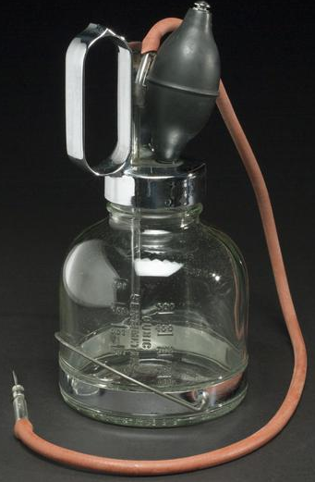
Prior Art on Reusable Sets
Rubber-Glass Blood Transfusion Set (1943) ¹¹
Materials: glass, rubber, silicone
Autoclavable
Reusable
Issues
Not sterile, blood retention ⁵
Material degradation ⁵
Complicated setup
Transitioned to disposable sets for safety reasons
Glass
Rubber-Silicone Tubing
5. JohnF. Wilkinson, G. G. Freeman, N. New, and R. B. Noad, “SILICONE-RUBBER TUBING IN BLOOD-TRANSFUSION WORK: CLINICAL TRIALS,” The Lancet, vol. 268, no. 6943, pp. 621–624, Sep. 1956, doi: 10.1016/S0140-6736(56)92310-8.
https://collection.sciencemuseumgroup.org.uk/objects/co8032045/blood-transfusion-set-united-states-1933-1943\
Notes:
Reusable sets are typically constructed of glass rubber and silicone
They were the earliest models for blood transfusion sets and were put through autoclaves between uses
An example of such a set is shown in the figure on the right
This resulted in a lot of adverse reactions to the sets
Further research discovered that silicone and rubber hold blood and also degrade over time after autoclaving
HICs have had the privilege to transfer entirely to disposable sets, but this is not feasible for LMICs, so it is important to consider how to make a sterilizable alternative

Slide 8
Brainstorming
Notes:
Darcy

Slide 9
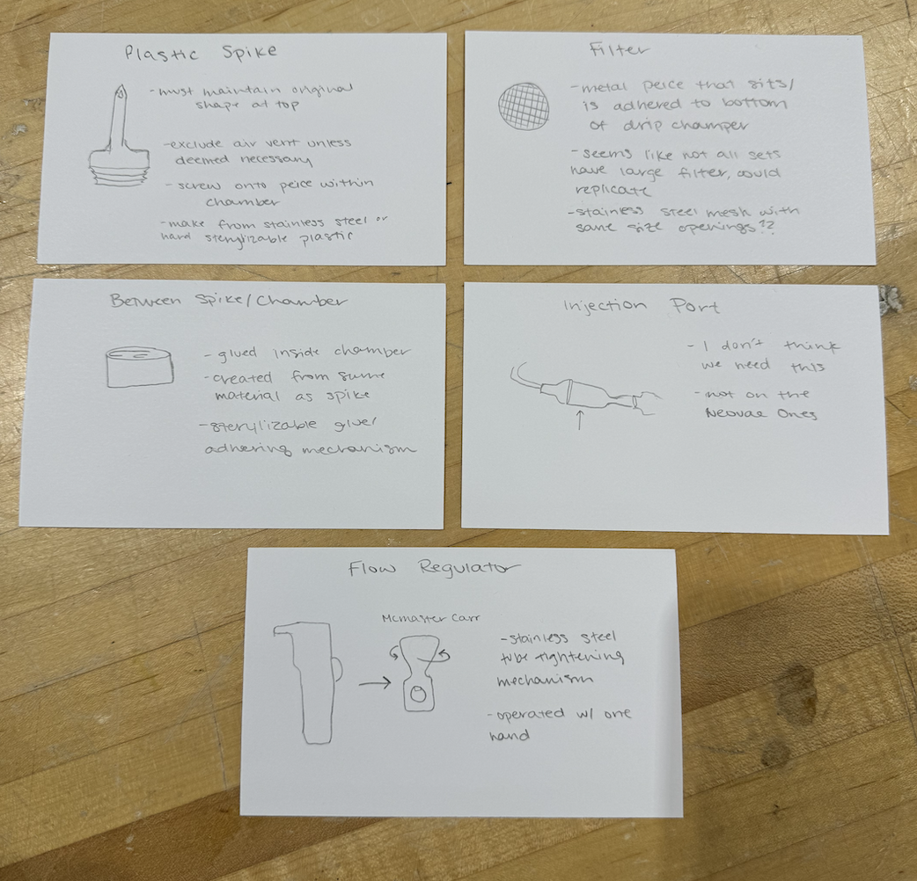
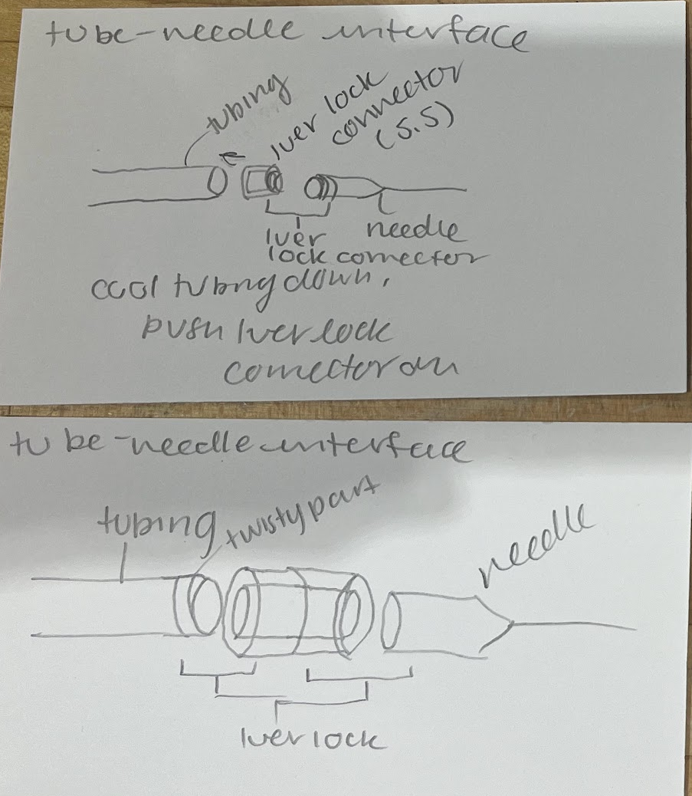
Individuals Brainstorming to Spark Innovation
Hannah’s individual brainstorming notecards
Michaela’s individual brainstorming notecards
Notes:
For our first method of brainstorming we chose to do individual brainstorming where we took 10 minutes to come up with as many ideas as possible and then share.
Here are some examples of ideas that wer suggested during this brainstorming session
Two ideas I came up with were …
Two ideas Michaela came up with were…

Slide 10
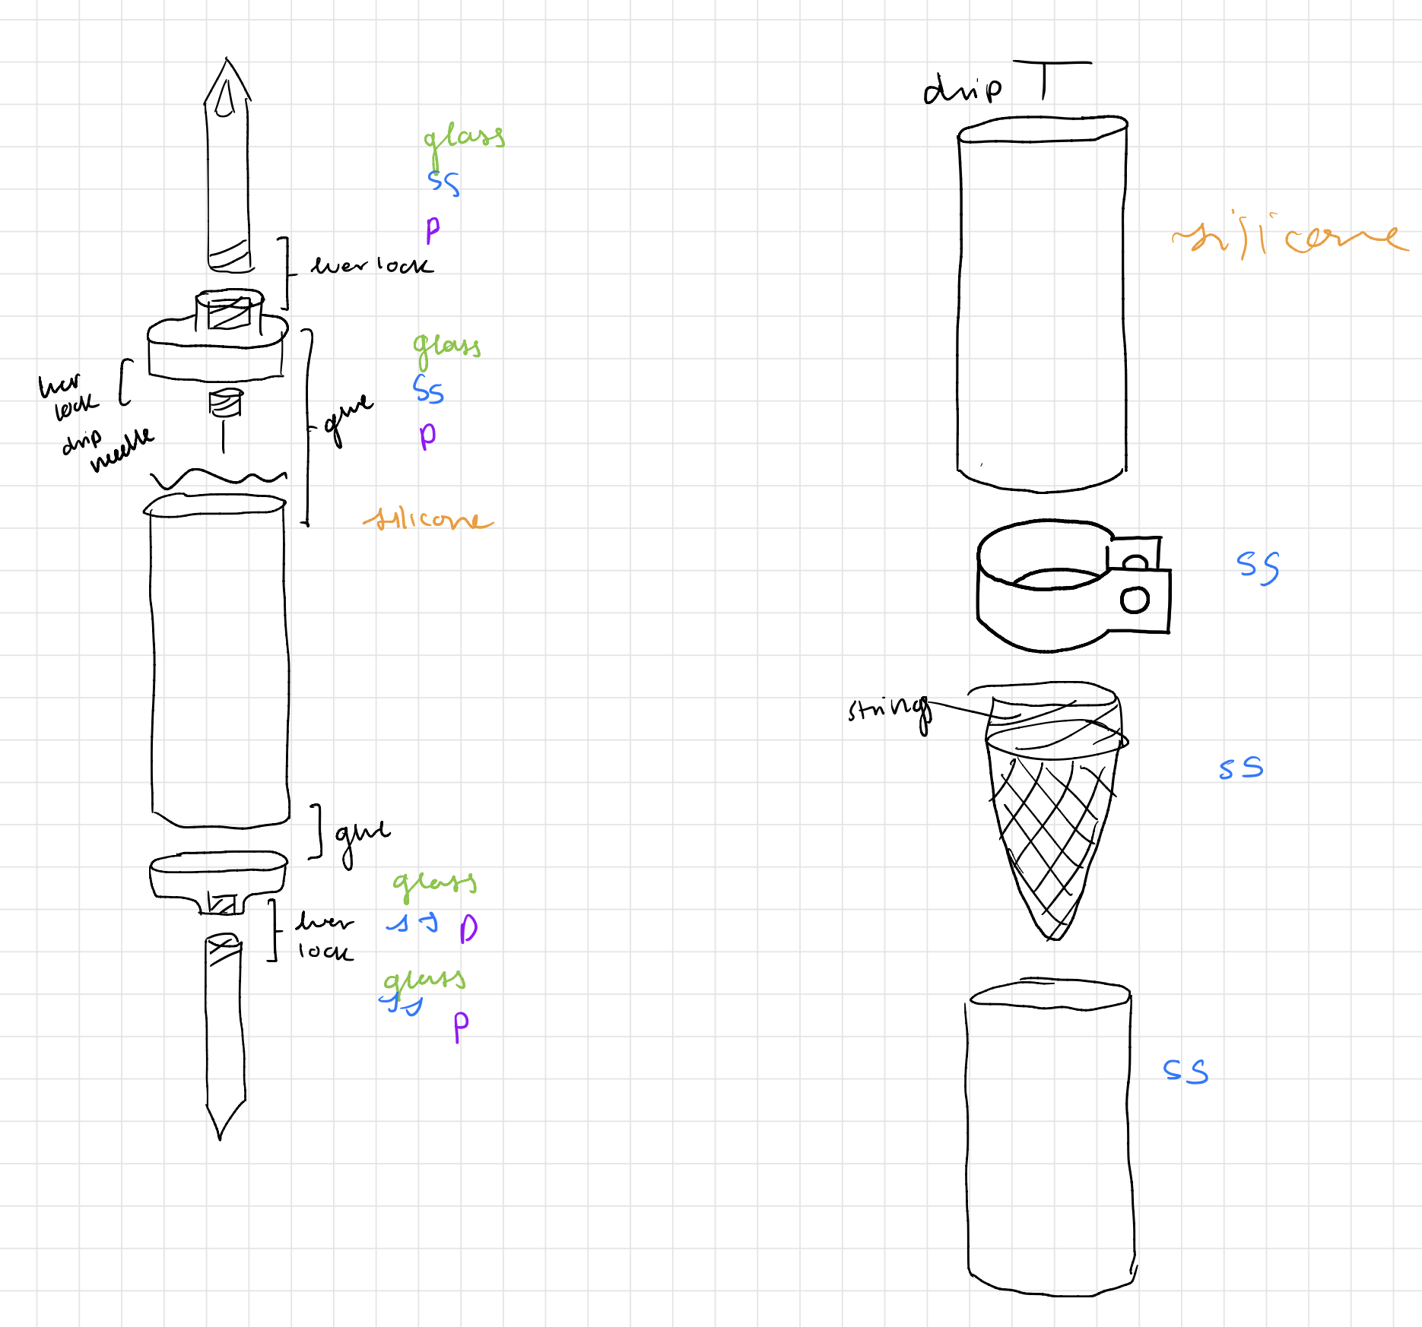
Component-based Brainstorming to Break Down our Design
Spike Components
Drip Chamber Components
Notes:
To further break down the design goals of our project we decided to do our next brainstorming by component. On the slide shows two of our main design components the spike and drip chamber part of our blood transfusion set. This really helped us visualize how our transfusion set will connect together and allowed us to understand all of the individual design constraints in addition to the overall design objectives.

Slide 11
Design Decisions
Notes:
Jason

Slide 12
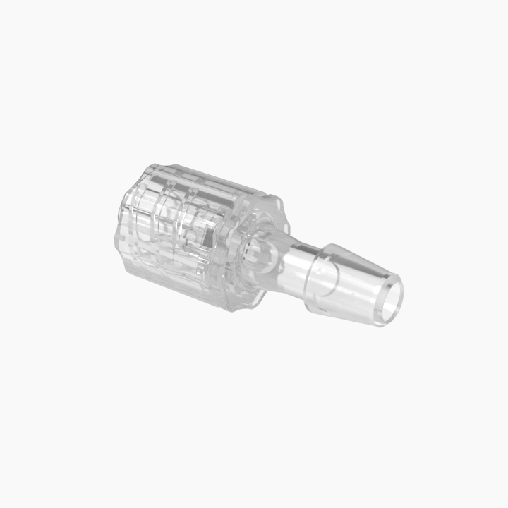
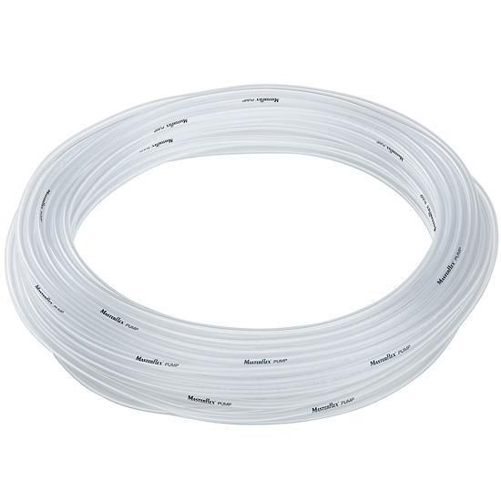
Some Components Didn’t Need a Trade Study
Tubing
Needle Connection
Needs to be sterilizable and standard sizing
Can be sourced
Male Rotating Luer Lock ¹⁴
Must be standard luer lock connection to maintain compatibility
Masterflex® L/S® Precision Pump Tubing, Platinum-Cured Silicone ¹³
Notes:
Some of the components were easy decisions without much room for change
Platinum Cured Silicone Tubing (had to have a certain Inner Diameter and Sterilizable which is why platinum cured)
Needle Connection (had to be standard connection so that it was compatible with the needles)

Slide 13
Other Components Needed a More In-Depth Decision Making Process
Spike and Drip Chamber
Flow Regulator
Permanent Connections
How many components will we break up the design into?
How will we connect these components?
How will we implement the filter?
What design will be the easiest to disassemble and sterilize?
What designs will allow for the best flow modulation and stopping?
How will we adhere certain parts together in a way that is airtight, autoclavable, and durable?
Notes:
Others needed further consideration such as…
Spike and drip chamber (with the different design questions)
So we conducted trade studies to determine our design for these components
Flow regulator (with questions)
Connections (With question)

Slide 14
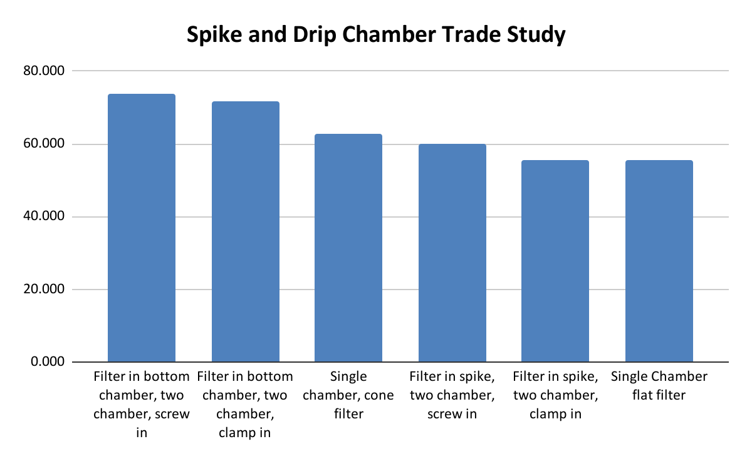
We Conducted Trades Studies to Make These Decisions
Notes:
The winning factor here was that we

Slide 15
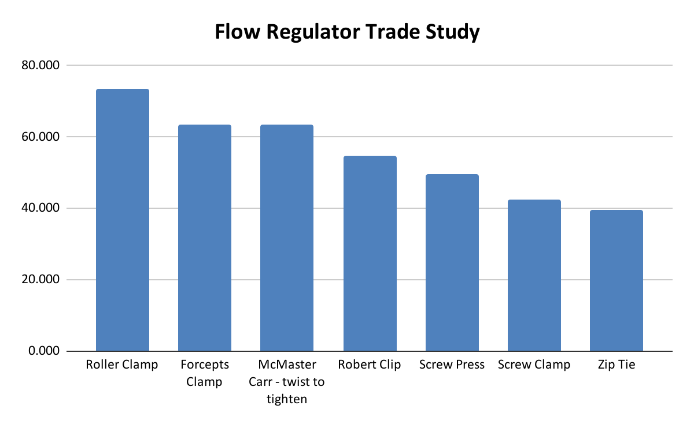
We Conducted Trades Studies to Make These Decisions

Slide 16
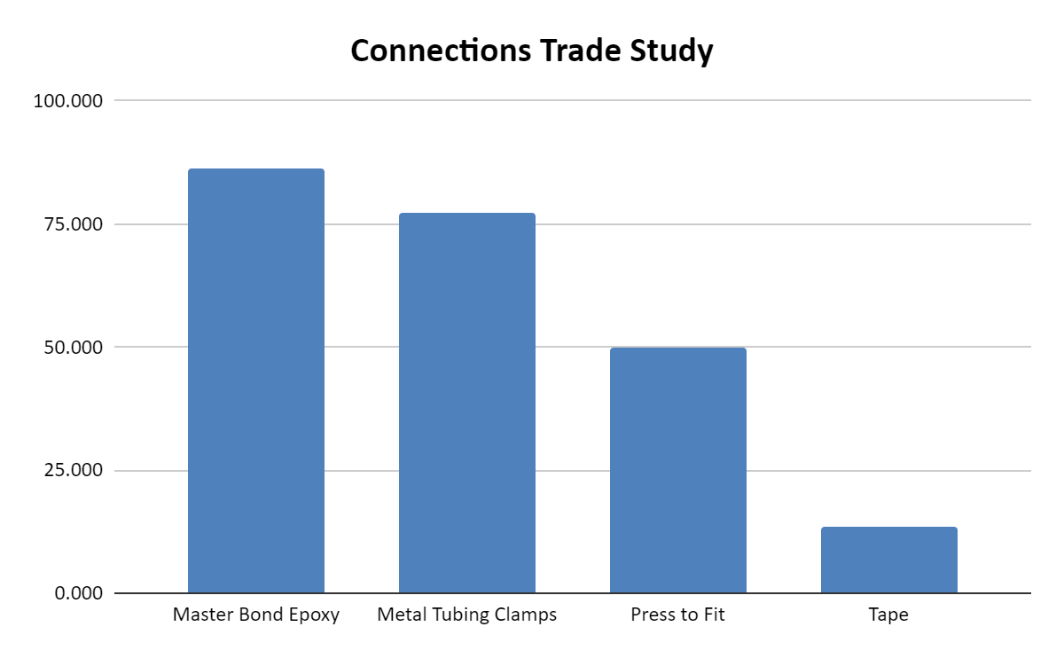
We Conducted Trades Studies to Make These Decisions

Slide 17
Design Implementation
Notes:
Jason

Slide 18
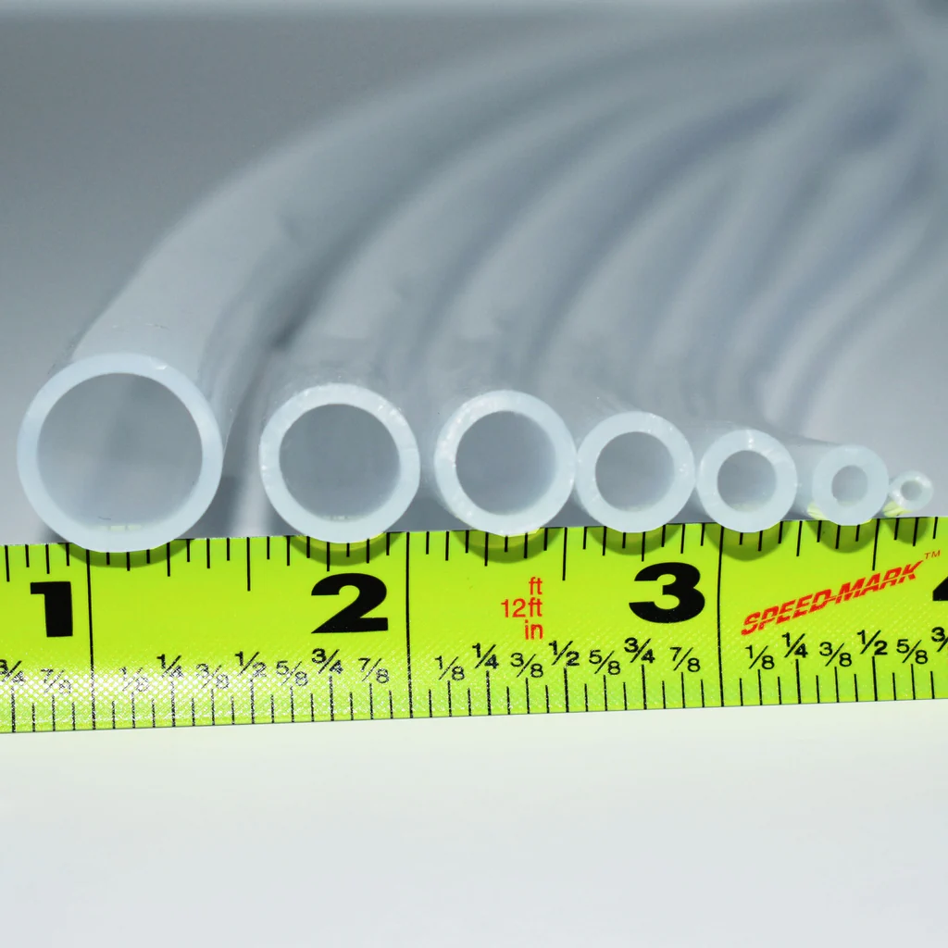
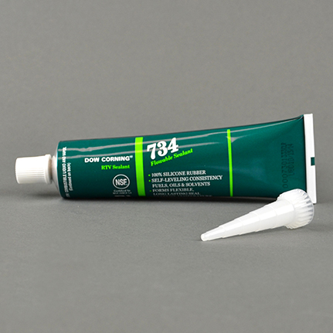
We Were Able to Source Our Tubing and Adhesive
Main Line Tubing
Drip Chamber Tubing
Adhesive
Masterflex® L/S® Precision Pump Tubing, Platinum-Cured Silicone ¹³
Ultra Clear Pure Silicone Tubing ¹⁵
Dow DOWSIL™ 734 Flowable Sealant Clear 90mL Tube ¹⁶

Slide 19
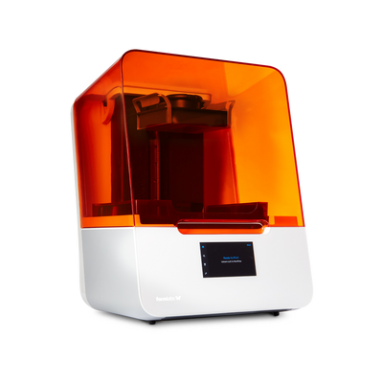
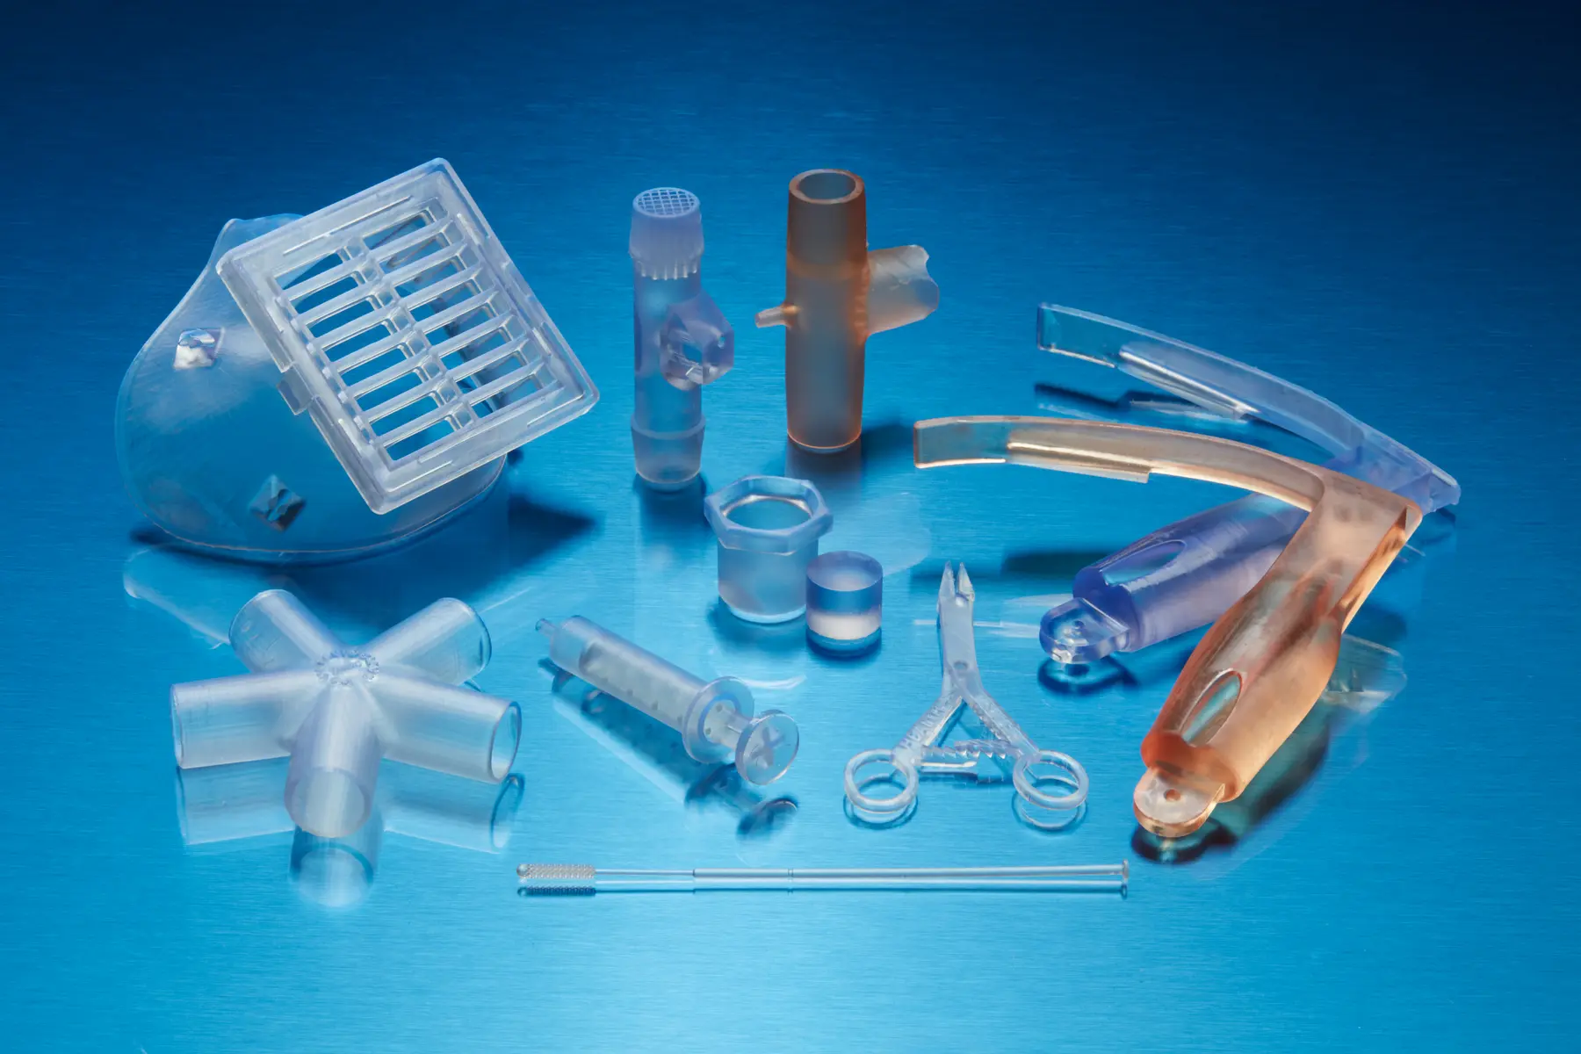
Other Components are 3D Printable out of Biomed Resin on an SLA Printer
Sterilizable
Biocompatible
High Strength
Biomed Clear Resin Sample Products ¹⁷
Formlabs SLA Printer ¹⁸
Autoclavable
Mucosal Membrane Contact (>30hrs)
84.0 MPa Flexural Strength

Slide 20
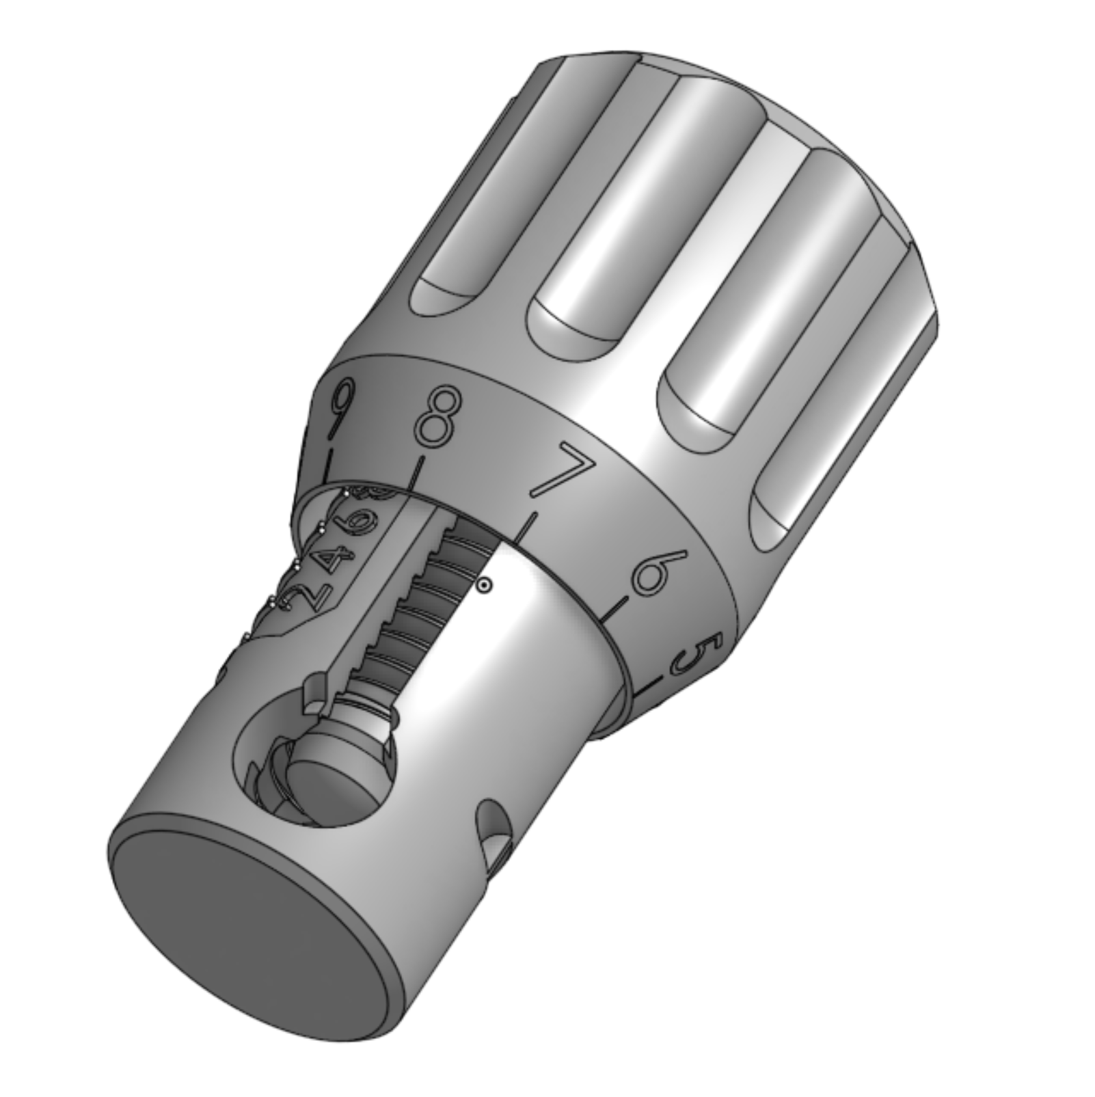
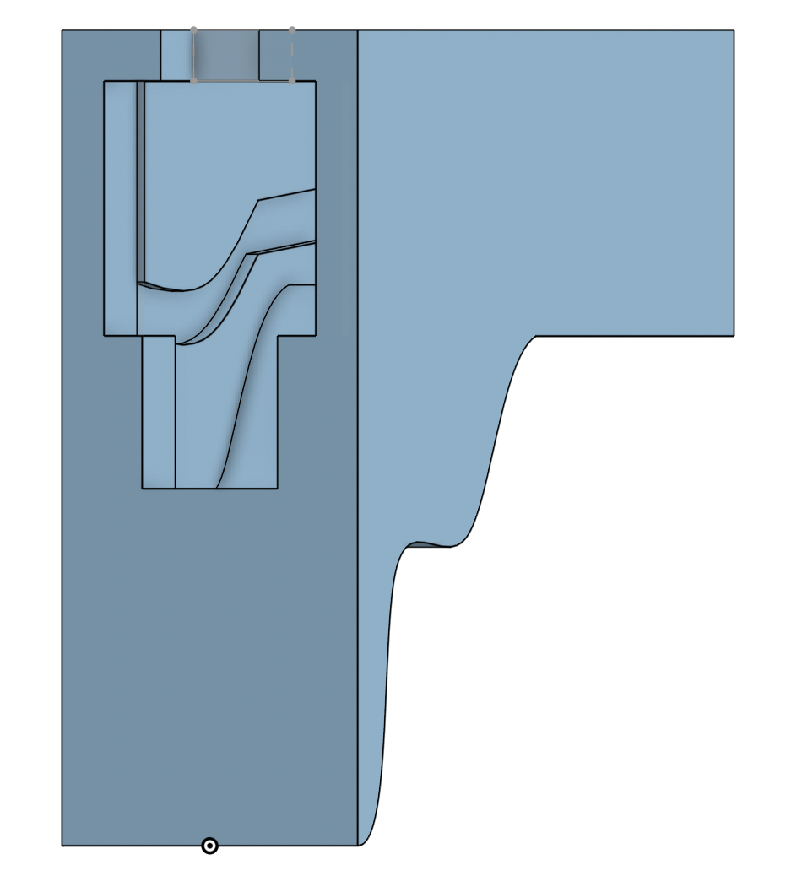
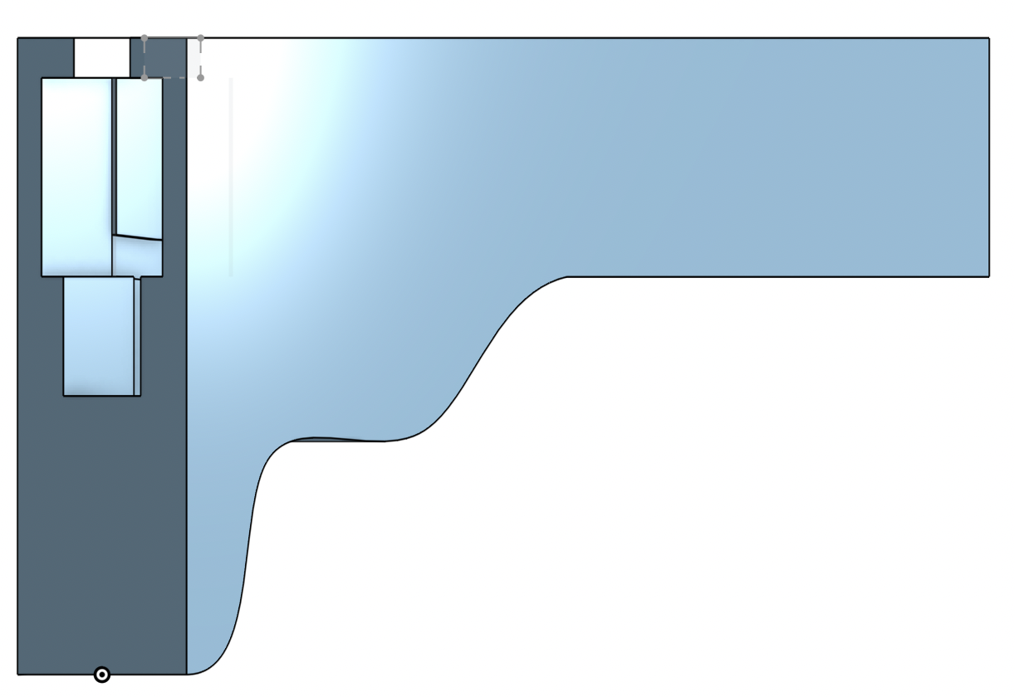
Our First Flow Regulator Iterations
CAD rendering of the Mcmaster Carr flow adjustment valve
CAD rendering of roller clamp

Slide 21
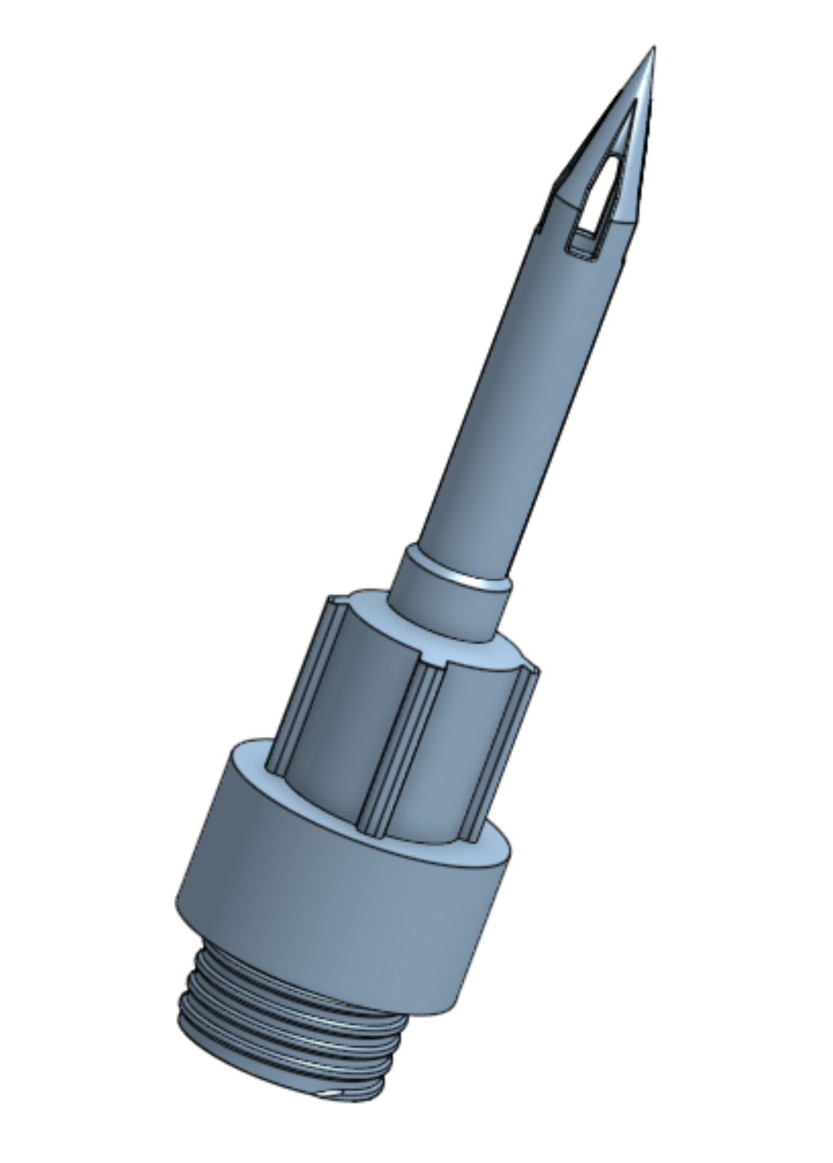
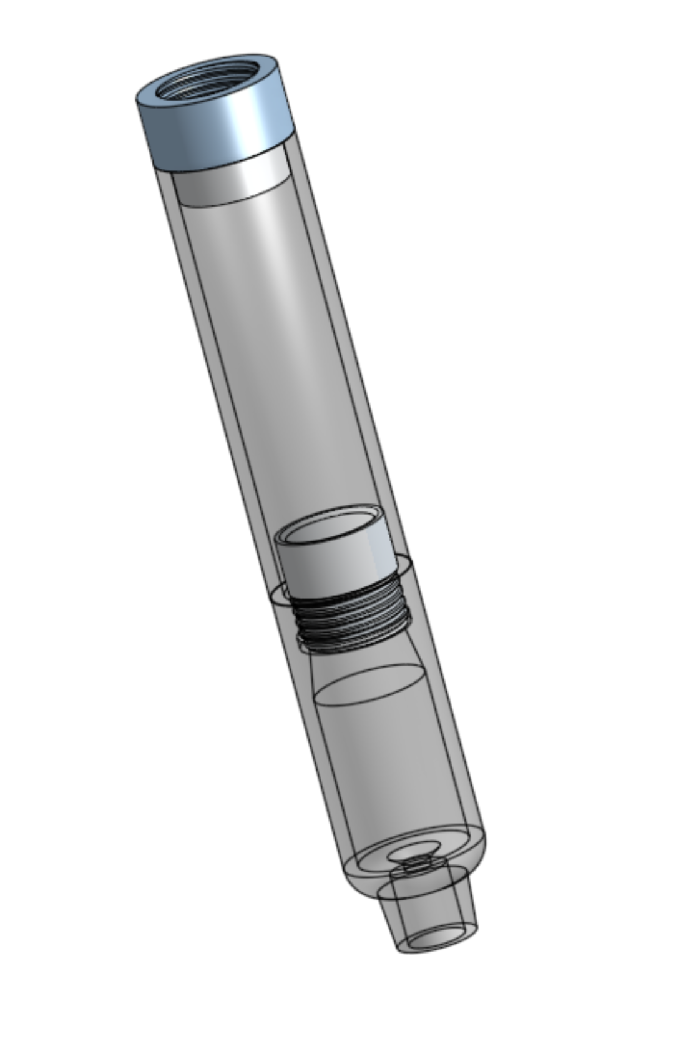
Our First Spike and Drip Chamber Iterations
CAD rendering of the current spike design
CAD rendering of the current drip chamber design

Slide 22
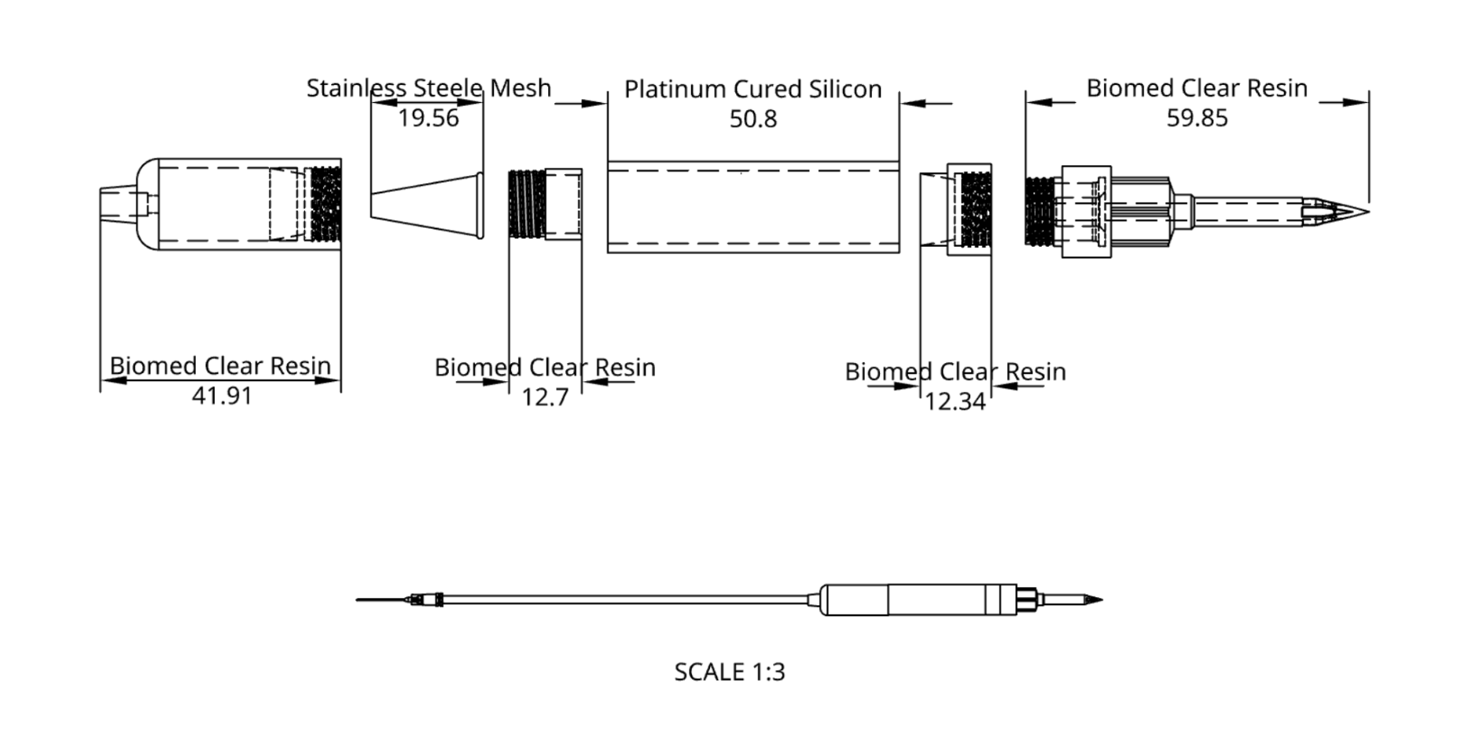
The Complete Transfusion Set
Technical drawing for the complete transfusion set

Slide 23
Gantt Chart
Notes:
Darcy

Slide 24
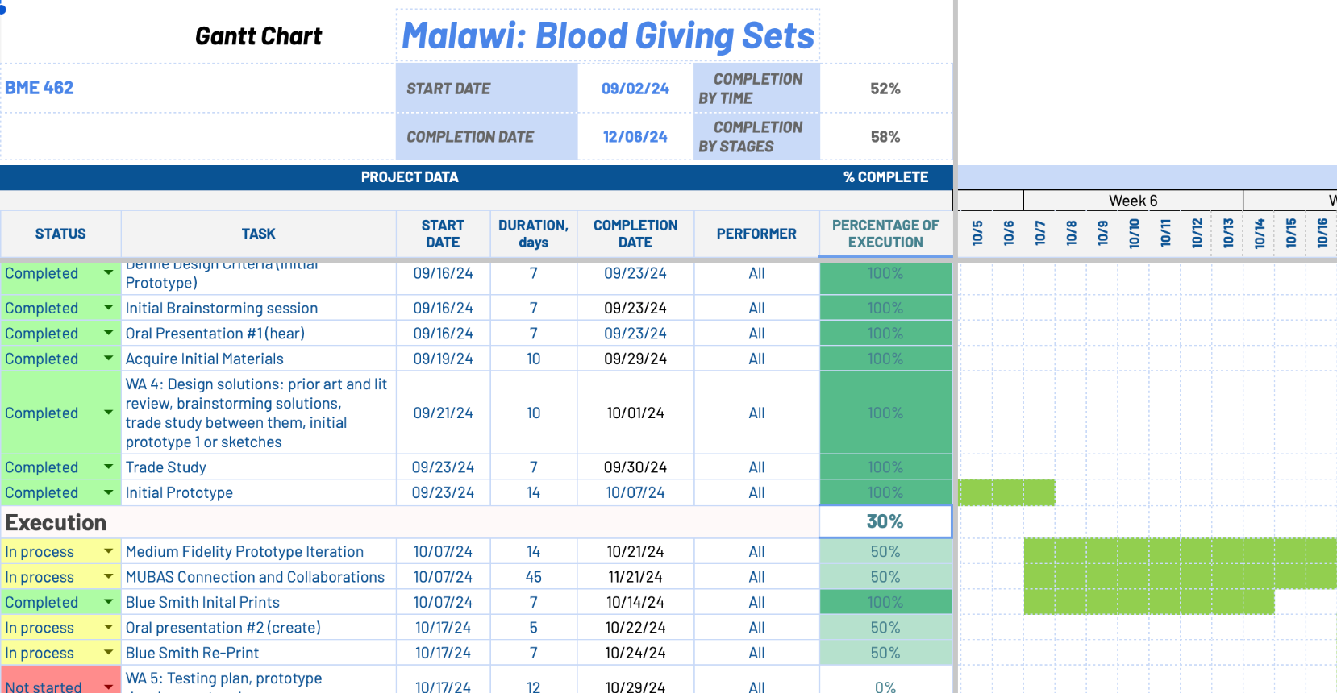
Link

Slide 25
References
"ISO 8536-4:2019 Transfusion Equipment for Medical Use - Part 4: Transfusion Sets for Single Use, Gravity Feed," International Organization for Standardization, 2019.
“ISO 10993-1:2018 Biological evaluation of medical devices - Part 1: Evaluation and testing within a risk management process,” International Organization for Standardization, 2018.
Interview with client, Dr. Alaniz and Dr. Hope, Sep. 11, 2024.
Y. Yang, X. Zhang, J. Li, Y. Liu, “Disposable Blood Transfusion Device for Conveniently Cleaning Pipeline,” CN202942487U, 2013.
JohnF. Wilkinson, G. G. Freeman, N. New, and R. B. Noad, “SILICONE-RUBBER TUBING IN BLOOD-TRANSFUSION WORK: CLINICAL TRIALS,” The Lancet, vol. 268, no. 6943, pp. 621–624, Sep. 1956, doi: 10.1016/S0140-6736(56)92310-8.
J. H. Stokes and G. J. Busman, “TUBING AS A CAUSE OF REACTION TO INTRAVENOUS INJECTION, ESPECIALLY OF ARSPHENAMIN: PRELIMINARY REPORT,” JAMA, vol. 74, no. 15, p. 1013, Apr. 1920, doi: 10.1001/jama.1920.02620150021008.
I. M. Libkach, “Blood Program in World War II: Office of the Surgeon‐General Department of the Army: Washington D.C. U.S.A.1964. Pp. 922. Price $8.00.,” Int J Clinical Practice, vol. 20, no. 1, pp. 57–57, Jan. 1966, doi: 10.1111/j.1742-1241.1966.tb06957.x.
L. Zimmerman and K. Howell, “History of Blood Transfusion,” in Annals of Medical History, vol. IV, 1932, p. 19. [Online]. Available: https://www.ncbi.nlm.nih.gov/pmc/articles/PMC7945273/pdf/annmedhist148147-0003.pdf
J. Curtis and A. Colas, “Chapter II.5.18 - Medical Applications of Silicones,” in Biomaterials Science (Third Edition), B. D. Ratner, A. S. Hoffman, F. J. Schoen, and J. E. Lemons, Eds., Academic Press, 2013, pp. 1106–1116. doi: 10.1016/B978-0-08-087780-8.00107-8.
pat, “Blood Infusion Set Disposable Transfusion Set With Flow Regulator,” https://www.china-kamed.com/. Accessed: Oct. 20, 2024. [Online]. Available: https://www.china-kamed.com:443/blood-infusion-set-disposable-transfusion-set-with-flow-regulator-product/
“Blood transfusion set, United States, 1933-1943 | Science Museum Group Collection.” Accessed: Oct. 20, 2024. [Online]. Available: https://collection.sciencemuseumgroup.org.uk/objects/co8032045/blood-transfusion-set-united-states-1933-1943
“What is a blood transfusion set? - Kmed-Leading infusion set manufacturer,disposable medicals supplier,” https://www.kmedhealth.com/, Apr. 16, 2021. https://www.kmedhealth.com/what-is-a-blood-transfusion-set/
Notes:
https://www.kmedhealth.com/wp-content/uploads/2024/03/ISO-8536-4-2019.pdf
https://www.iso.org/obp/ui/en/#iso:std:iso:10993:-1:ed-5:v2:en

Slide 26
References
“Masterflex® L/S® Precision Pump Tubing, Platinum-Cured Silicone, L/S 16; 25 ft,” VWR. Accessed: Oct. 21, 2024. [Online]. Available: https://us.vwr.com/store/item/NA5144597/masterflex-l-s-precision-pump-tubing-platinum-cured-silicone-avantor
“LMRLN-3PP,” Eldon James. Accessed: Oct. 21, 2024. [Online]. Available: https://eldonjames.com/product/lmrln-3pp/
“Ultra Clear Pure Silicone Tubing by the foot - All Sizes,” Cold & Colder. Accessed: Oct. 22, 2024. [Online]. Available: https://coldandcolder.com/products/silicone
“Dow DOWSIL™ 734 Flowable Sealant Clear 90 mL Tube.” Accessed: Oct. 22, 2024. [Online]. Available: https://www.ellsworth.com/products/by-manufacturer/dow/sealants/silicone/dow-734-flowable-plus-silicone-clear-90-ml-tube/
“Formlabs BioMed Clear Resin (Form 4) 1 L - TriMech Store.” Accessed: Oct. 21, 2024. [Online]. Available: https://store.trimech.com/products/formlabs-biomed-clear-resin-form-4-1l
“Buy Form 3B+ Basic Medical Package,” Formlabs. Accessed: Oct. 21, 2024. [Online]. Available: https://formlabs.com/store/3d-printers/form-3b-medical-package/#/
Formlabs, Inc., BioMed Clear Biocompatible Photopolymer Resin for Formlabs SLA Printers, Rev. 04, Apr. 24, 2023. Accessed: Oct. 20, 2024. [Online]. Available: https://formlabs.com/medical
‌
Notes:
https://www.kmedhealth.com/wp-content/uploads/2024/03/ISO-8536-4-2019.pdf
https://www.iso.org/obp/ui/en/#iso:std:iso:10993:-1:ed-5:v2:en

Slide 27
Malawi Blood Giving Sets
Pothawira Surgical Center
Darcy Ayers, Micheala Harris,
Jason Hoffman, Hannah Kragt

Slide 28
Exploring Different Component Materials
 | Rubber ^{6,7} | Glass ^{7,8} | Silicone ⁵ | Platinum-Cured Silicone ⁹
Non-toxic |  | ✓ | ✓ | ✓
Autoclavable | ✓ | ✓ | ✓ | ✓
Flexible | ✓ |  | ✓ | ✓
Does not retain liquid |  | ✓ |  | ✓
Supplemental Slide
5. JohnF. Wilkinson, G. G. Freeman, N. New, and R. B. Noad, “SILICONE-RUBBER TUBING IN BLOOD-TRANSFUSION WORK: CLINICAL TRIALS,” The Lancet, vol. 268, no. 6943, pp. 621–624, Sep. 1956, doi: 10.1016/S0140-6736(56)92310-8.
6. J. H. Stokes and G. J. Busman, “TUBING AS A CAUSE OF REACTION TO INTRAVENOUS INJECTION, ESPECIALLY OF ARSPHENAMIN: PRELIMINARY REPORT,” JAMA, vol. 74, no. 15, p. 1013, Apr. 1920, doi: 10.1001/jama.1920.02620150021008.
7. I. M. Libkach, “Blood Program in World War II: Office of the Surgeon‐General Department of the Army: Washington D.C. U.S.A.1964. Pp. 922. Price $8.00.,” Int J Clinical Practice, vol. 20, no. 1, pp. 57–57, Jan. 1966, doi: 10.1111/j.1742-1241.1966.tb06957.x.
8. L. Zimmerman and K. Howell, “History of Blood Transfusion,” in Annals of Medical History, vol. IV, 1932, p. 19. [Online]. Available: https://www.ncbi.nlm.nih.gov/pmc/articles/PMC7945273/pdf/annmedhist148147-0003.pdf
9. J. Curtis and A. Colas, “Chapter II.5.18 - Medical Applications of Silicones,” in Biomaterials Science (Third Edition), B. D. Ratner, A. S. Hoffman, F. J. Schoen, and J. E. Lemons, Eds., Academic Press, 2013, pp. 1106–1116. doi: 10.1016/B978-0-08-087780-8.00107-8.
Notes:
Comparison of different materials we will use for components in the overall set r

Slide 29
International Standards for Medical Devices: Design
and Biocompatibility Requirements
Set by International Organization for Standardization (ISO)
ISO 1135-4:2019 - Design requirements for disposable blood transfusion sets ¹
Guidelines for design, materials, and safety requirements
Standards for sterility of the internal parts, physical properties of the tubing, and the capability to maintain a proper flow rate of blood
Provides testing methods to ensure that products are up to standard
ISO 10993-1:2018 - Biocompatibility requirements for medical devices ²
Similar guidelines to ISO 1135-4:2019, but with more rigorous chemical testing metrics
Supplemental Slide
1. "ISO 8536-4:2019 Transfusion Equipment for Medical Use - Part 4: Transfusion Sets for Single Use, Gravity Feed," International Organization for Standardization, 2019.
2. “ISO 10993-1:2018 Biological evaluation of medical devices - Part 1: Evaluation and testing within a risk management process,” International Organization for Standardization, 2018.
Notes:
https://www.kmedhealth.com/wp-content/uploads/2024/03/ISO-8536-4-2019.pdf
https://www.iso.org/obp/ui/en/#iso:std:iso:10993:-1:ed-5:v2:en

Slide 30
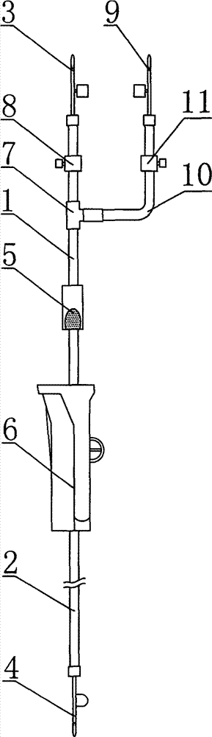
New Patented Designs for Disposable Blood
Transfusion Sets Focus on Ease of Use
Diagram of patent CN202942487U design ⁴
CN202942487U ⁴
Novel design of infusion port with two connectors to easily switch between liquids (ex. saline and blood)
Unnecessary complexity in LMIC, where main priority is efficient transfusion and minimal components necessary to sterilize
Not sterilizable, made of noncompliant plastics
Supplemental Slide
4. Y. Yang, X. Zhang, J. Li, Y. Liu, “Disposable Blood Transfusion Device for Conveniently Cleaning Pipeline,” CN202942487U, 2013..

Slide 31
Silicone Material Failure in Reusable
Sets⁵
After several rounds through autoclave, material did not display ideal properties
Blood retention
Increased weight of component indicated trace blood coagulation in material
Reaction in 1% of patients due to cross contamination
Material degradation
Loss of tensile strength
Slight leakage
Supplemental Slide
5. JohnF. Wilkinson, G. G. Freeman, N. New, and R. B. Noad, “SILICONE-RUBBER TUBING IN BLOOD-TRANSFUSION WORK: CLINICAL TRIALS,” The Lancet, vol. 268, no. 6943, pp. 621–624, Sep. 1956, doi: 10.1016/S0140-6736(56)92310-8.

Slide 32
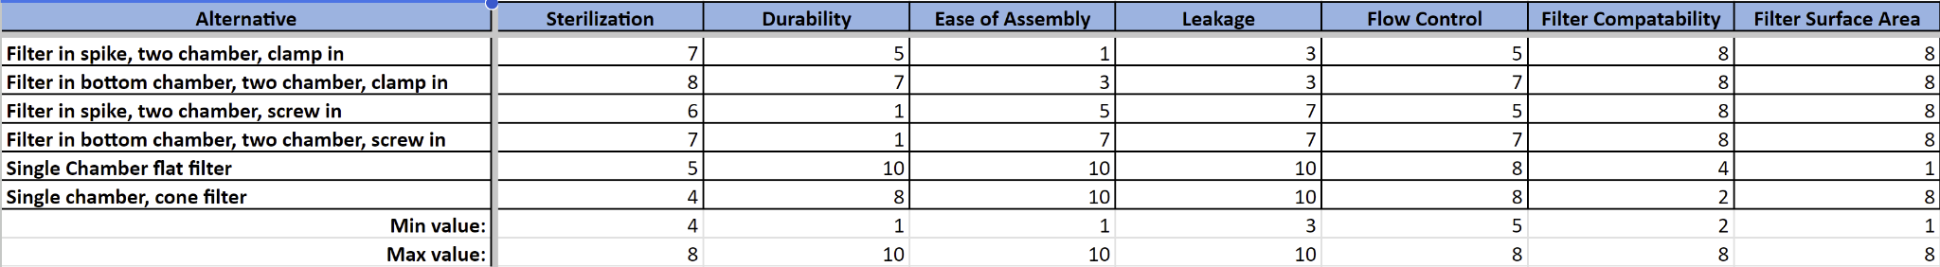
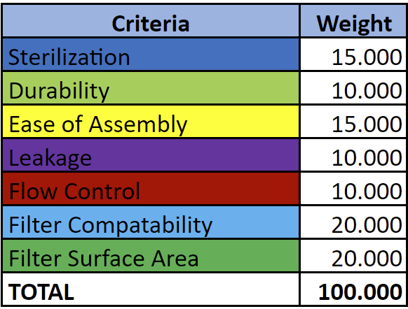
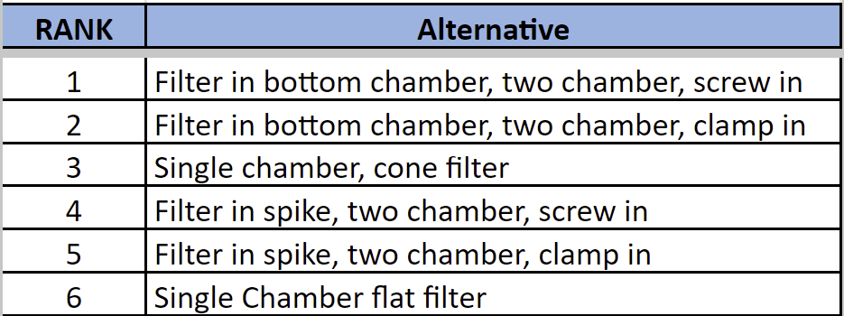
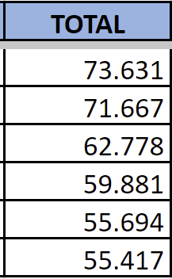
Spike and Drip Chamber Trade Study
Supplemental Slide

Slide 33
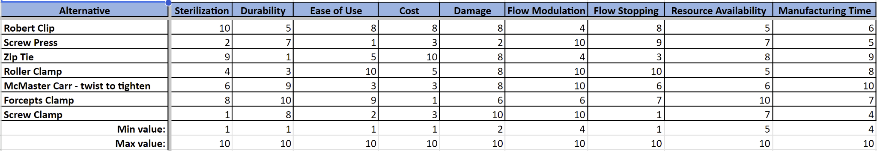
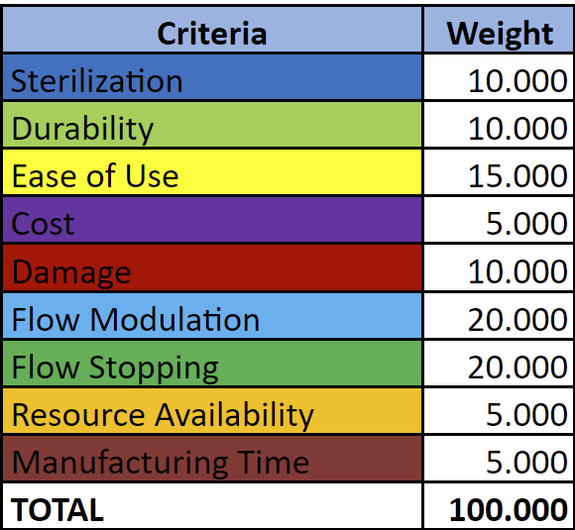
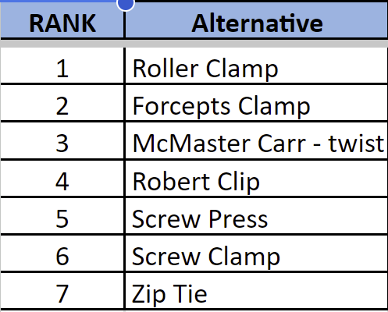
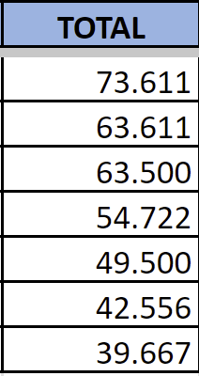
Flow Regulator Trade Study
Supplemental Slide

Slide 34
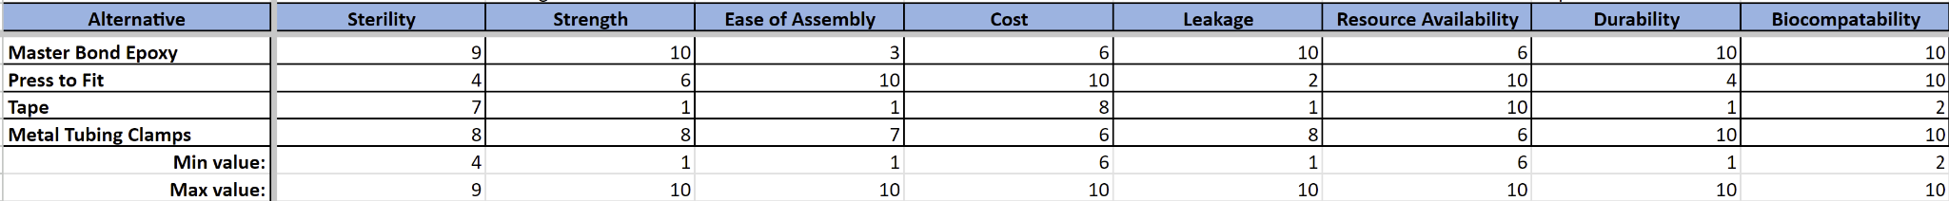
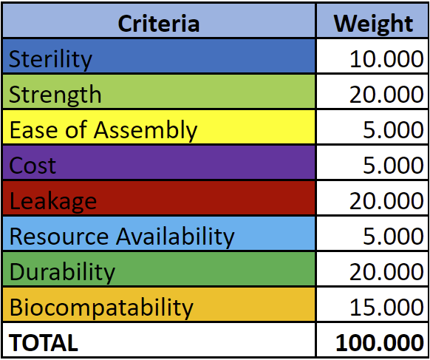
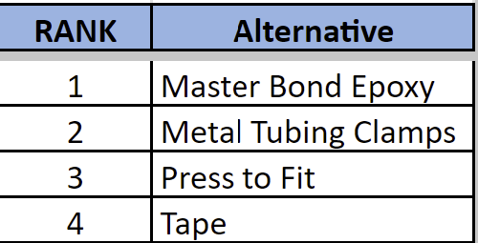
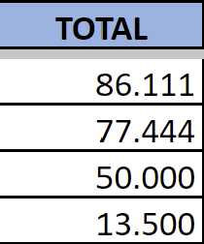
Connections Trade Study
Supplemental Slide
Notes:
Highlight top choices

Slide 35
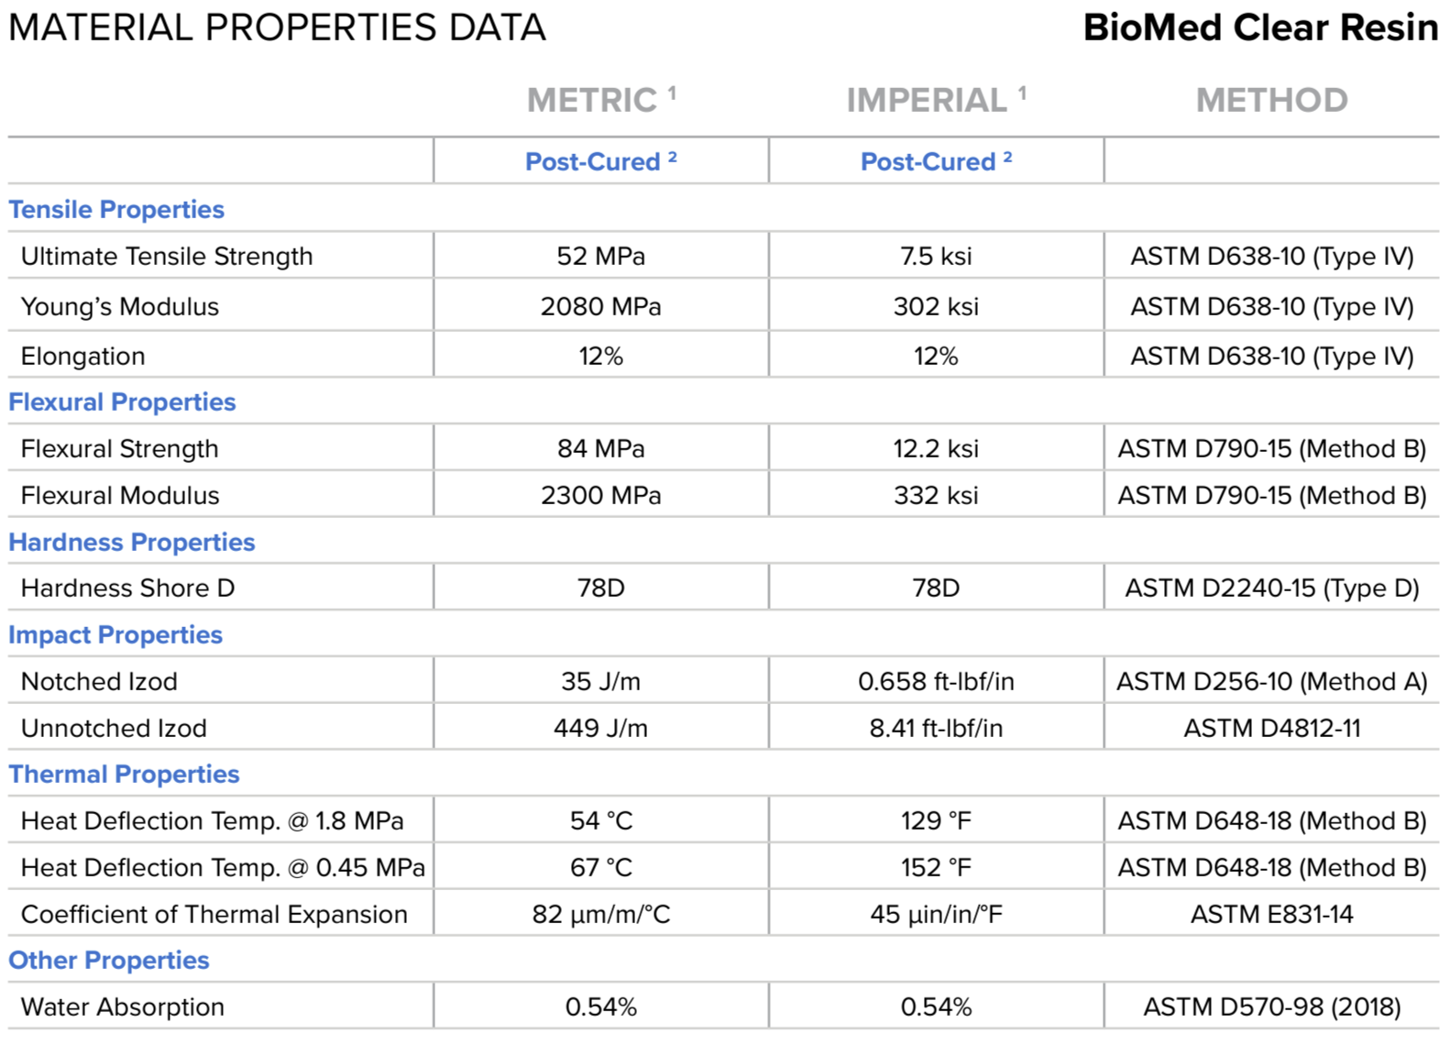
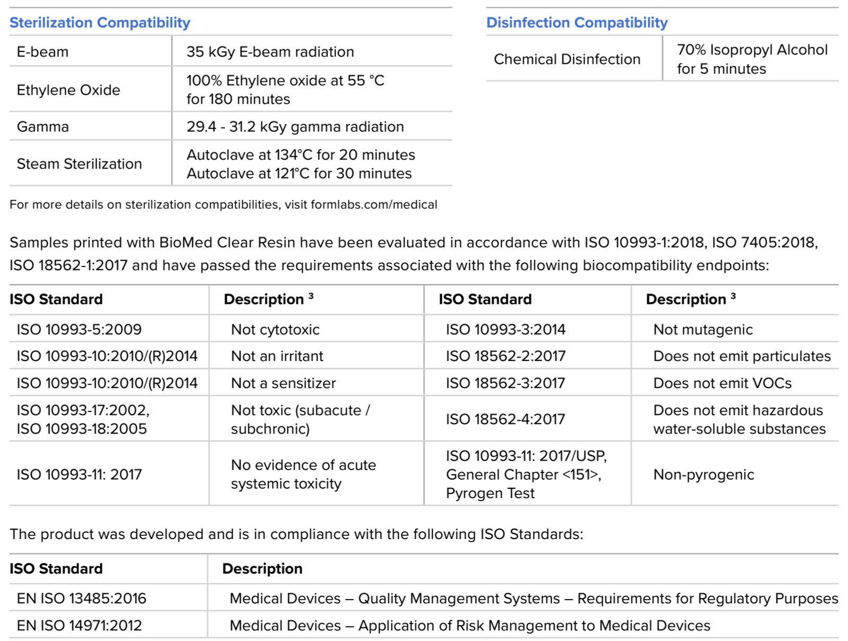
Using SLA Printing for Components
Material Properties of Biomed Clear Resin ¹⁹
Formlabs, Inc., BioMed Clear Biocompatible Photopolymer Resin for Formlabs SLA Printers, Rev. 04, Apr. 24, 2023. Accessed: Oct. 20, 2024. [Online]. Available: https://formlabs.com/medical
Supplemental Slide

Slide 36
Concepts for Future Design Iterations
Locking Screw-Ins
Silicone Bumper at Connections
Dial in Tolerancing
Increase ease-of-Use
Lock to maintain pressure on bumpers
Press and turn to lock
Airtight at connections
Use PC silicone cut out of existing tubing to line the female connection
Ensure a tight fit and precise parts
Trial and error with the printer
Supplemental Slide

